Slide 1
COMPUTER SECURITY

Slide 2
Key Management
public-key encryption helps address key distribution problems
have two aspects of this:
distribution of public keys
use of public-key encryption to distribute secret keys

Slide 3
Distribution of Public Keys
Several techniques for the distribution of public keys
public announcement
publicly available directory
public-key authority
public-key certificates

Slide 4
Public Announcement
users distribute public keys to recipients or broadcast to community at large
major weakness is forgery
anyone can create a key claiming to be someone else and broadcast it
until forgery is discovered forger can masquerade as claimed user

Slide 5
Publicly Available Directory
can obtain greater security by registering keys with a public directory
directory must be trusted with properties:
contains {name,public-key} entries
participants register securely with directory
participants can replace key at any time
directory is periodically published
directory can be accessed electronically
still vulnerable to tampering or forgery

Slide 6
Public-Key Authority
improve security by tightening control over distribution of keys from directory
A central authority has properties of directory
It requires users to know public key for the authority and the corresponding private key is known only to the authority.
then users interact with authority to obtain any desired public key securely
does require real-time access to directory when keys are needed

Slide 7
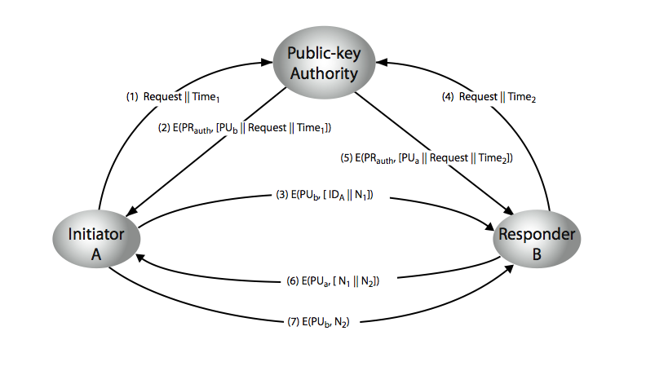

Slide 8
Public-Key Certificates
certificates allow key exchange without real-time access to public-key authority
a certificate binds identity to public key
with all contents signed by a trusted Public-Key or Certificate Authority (CA)
can be verified by anyone who knows the public-key authorities public-key

Slide 9
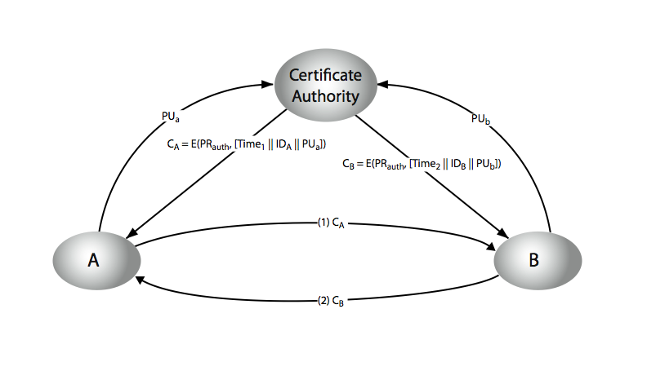

Slide 10
Public-Key Distribution of Secret Keys
Simple secret key distribution
Secret key distribution with confidentiality and authentication
Hybrid scheme

Slide 11
Simple Secret Key Distribution
proposed by Merkle in 1979
A generates a new temporary public key pair
A sends B the public key and its identity
B generates a session key K sends it to A encrypted using the supplied public key
A decrypts the session key
problem is that an opponent can intercept and impersonate both halves of protocol

Slide 12


Slide 13
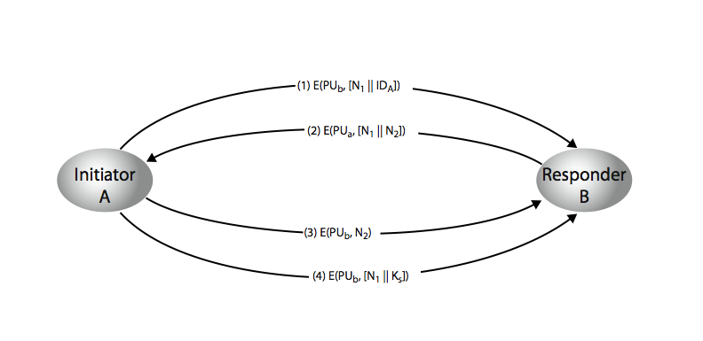
Secret key distribution with confidentiality and authentication

Slide 14
Hybrid scheme
Three level scheme
retain use of private-key KDC
shares secret master key with each user
distributes session key using master key
public-key used to distribute master keys

Slide 15
MESSAGE AUTHENTICATION AND HASH FUNCTIONS

Slide 16
Message Authentication
Message authentication is a mechanism or service used to verify the integrity of a message. Message authentication assures that data received are exactly as sent by (i.e., contain no modification, insertion, deletion, or replay) and that the purported identity of the sender is valid.
Symmetric encryption provides authentication among those who share the secret key. Encryption of a message by sender’s private key also provides a form of authentication.

Slide 17
The two most common technique for message authentication are message authentication code (MAC) and hash function

Slide 18
AUTHENTICATION REQUIREMENTS
disclosure
traffic analysis
masquerade
content modification
sequence modification
timing modification
source repudiation
destination repudiation

Slide 19
AUTHENTICATION FUNCTIONS
The different types of functions that may be used to produce an authenticator are as follows:
Message encryption – the cipher text of the entire message serves as its authenticator.
Message authentication code (MAC) – a public function of the message and a secret key that produces a fixed length value serves as the authenticator.
Hash function – a public function that maps a message of any length into a fixed length hash value, which serves as the authenticator

Slide 20
Message encryption
Message encryption by itself can provide a measure of authentication
The analysis differs from symmetric and public key encryption schemes

Slide 21
Symmetric encryption

Slide 22
Public-key encryption

Slide 25
Message Authentication Code
An alternative authentication technique involves the use of secret key to generate a small fixed size block of data, known as cryptographic checksum or MAC that is appended to the message.
This technique assumes that two communication parties say A and B, share a common secret key ‘k’. When A has to send a message to B, it calculates the MAC as a function of the message and the key.

Slide 26
MAC = C(K, M) where
M= input message
C = MAC function
K= shared secret key
MAC = message authentication code

Slide 27
The message plus MAC are transmitted to the intended recipient.The recipient performs the same calculation on the received message, using the same secret key, to to generate a new MAC. The received MAC is compared to the calculated MAC. If it is equal, then the message is considered authentic.
A MAC function is similar to encryption. One difference is that MAC algorithm need not be reversible, as it must for decryption

Slide 28
Basic uses of MAC

Slide 30
Requirements for MAC:
The MAC function should have the following properties:
If an opponent observes M and C(K,M), it should be computationally infeasible for the opponent to construct a message M’ such that C(K,M’) = C(K,M)
C(K,M) should be uniformly distributed in the sense that for randomly chosen messages, M and M’, the probability that C(K,M) = CK(,M’) is 2^{-n} where n is the number of bits in the MAC.
Let M’ be equal to some known transformation on M. i.e., M’ = f(M).,Then Pr [MAC(K, M) = MAC(K, M’)] = 2^{-n}

Slide 31
MAC based on DES
One of the most widely used MACs, referred to as Data Authentication Algorithm (DAA) is based on DES.
The algorithm can be defined as using cipher block chaining (CBC) mode of operation of DES with an initialization vector of zero.
The data to be authenticated are grouped into contiguous 64-bit blocks: D1, D2 … Dn. if necessary, the final block is padded on the right with zeros to form a full 64-bit block.

Slide 32
Using the DES encryption algorithm and a secret key, a data authentication code (DAC) is calculated as follows:
O₁ = E(K,D₁)
O₂ = E(K,D₂ XOR O₁)
O₃ = E(K,[D₃ XOR O₂]) …
O_{N} = E(K,[D_{N} XOR O_{N-1}])

Slide 33
Data Authentication Algorithm (DAA)

